Slide 1
2019 MOAA-NH Granite State Warriors Award

Slide 2
Granite State Warriors Award Requirements and Selection Criteria
The New Hampshire Chapter of the Military Officers Association of America (MOAA-NH) established the Granite State Warriors Award in 2011 to annually recognize the superb contributions of a New Hampshire based organization and/or a New Hampshire resident that have:
Enhanced the war fighting capabilities of US military forces through the development and introduction of weapon systems and/or subsystems that have led to the strengthening of our national security or
Improved the health, morale, welfare, and recognition of US military personnel and their direct families through the creation and delivery of unique services either in the US or where are military forces are deployed. Such unique services are specifically designed to improve the quality of life of our military forces and their families.

Slide 3
2011 Recipients
Paul Moore, the founder and driving force of MooreMart. Established in 2004, MooreMart has provided over 44,000 “Care Packages” to members of the armed forces serving in the Middle East, Iraq, and Afghanistan, hospitalized armed forces personnel at the Walter Reed National Military Medical Center, residents of the New Hampshire Veterans Home in Tilton, NH, and homeless veterans in the state.
Joseph W. McQuaid, President and Publisher of the New Hampshire Union Leader and Photographer Bob LaPree for their leadership and content of the Union Leader’s coverage of the New Hampshire National Guard’s Charlie Company in Afghanistan. Written while embedded with Charlie Company in Afghanistan, the Union Leader’s coverage of the men and women of Charlie Company provided invaluable insight and recognition of their contributions to the War on Terror.

Slide 4
2012 Recipients
Pease Greeters have welcomed more than 500 flights and more than 200,000 military personnel passing through Pease International Tradeport transiting to and from various overseas battle zones. Pease Greeters have also shipped over 43,000 pounds of care packages to soldiers overseas.
Wilcox Industries has provided highly specialized tactical gear for military and law enforcement personnel for over 30 years. Wilcox is honored for its efforts to improve the effectiveness and survivability of the United States military in extreme combat conditions. As an example, Wilcox is the provider of all hand held weapons used by the US Navy SEALS.

Slide 5
2013 Recipients
Dr. and Mrs. Gerald Currier for their efforts to treat wounded warriors and their families with a magical New Hampshire Christmas experience. Starting as a Currier family endeavor in 2008, this has evolved into the Christmas Can Cure organization. It’s mission statement says it best “By granting that family in need a perfect (hopefully White) Christmas, perhaps that sadness becomes glee, fear becomes pride, depression becomes enthusiasm, and the holiday can give them a fresh start they need in the new year. Then, just maybe, the magic of Christmas can start the healing process in their lives and perhaps Christmas Can Cure.”
Veterans Count has provided financial assistance totaling nearly 1.5 million dollars to over 2350 families of all services. The regional statewide chapters have raised funds and awareness to help with a hand-up: providing care coordination that prevents suicides, prevents homelessness, helps with employment and increases readiness by reducing family stress. Veterans Count reaches out to all who have served our country in uniformed military service.

Slide 6
2014 Recipients
BAE Electronic Systems for their Advanced Precision Kill Weapon System (WGU-59/B) – that turns a standard unguided 2.75” rocket into a precision laser-guided munition giving the military a low-cost surgical strike capability.
Jo Moncher, Bureau Chief, New Hampshire Department of Health and Human Services. This position is the first of its kind in the country to help facilitate and develop partnerships between military and civilian health care providers. In her role at DHHS, Moncher works with the VA, vet centers, National Guard and other military and civilian provider agencies. She plays a key role in establishing military and civilian partnership communities than focus on homelessness, suicide prevention and substance abuse, among other problems

Slide 7
2015 Recipients
Veterans Law Project. Since January 2015, the Veterans Law Project has provided legal assistance to over 500 New Hampshire veterans and families of veterans. Legal assistance provided to veterans covers family law issues, housing and finance problems, criminal law, Veterans Administration benefits, estate planning and probate, discharge upgrades, Social Security disability and Workers Comp, and other legal matters throughout the State of New Hampshire. The Veterans Law Project provides veterans emergency access to legal professionals, offers in-house legal services and referrals at no cost to the veteran, reaches veterans and active duty service members both in New Hampshire and around the world, and encourages collaboration with community agencies and local resources. To provide these services, the Veterans Law Project utilizes highly experienced, veteran legal professionals, attorneys and paralegals who understand the unique needs of New Hampshire veterans.
Matthew Albuquerque, Founder and President of Next Step Bionics and Prosthetics. Having founded the human helping company to provide and fit high quality prosthetics for amputees of all ages over 25 years ago, he has been a leading consultant particularly for special use limbs tailored for veterans. He has provided DARPA level development of artificial limbs and specialty fittings for unique needs and uses. He has a strong veteran focus and served as the Chair for Easter Seals Veterans Count Advisory Board. As an American Board Certified Prosthetist and Orthotist, his emphasis is on serving those who have served. Matt is the “go to” authority for answers that solve the toughest veteran amputee questions.

Slide 8
2016 Recipients
Joe Byron, Executive Director and Founder of Honor Flights New England. Founded in 2009 to transport America’s Word War II Veterans to visit Washington, DC to visit hose memorials dedicated to honoring their service and sacrifices. In 2016, Honor Flight New England began transporting Korean Was Veterans. Trips are provided at no cost to the veterans. To date, 42 flights have been launched serving 1,474 veterans.
Harbor Homes was recognized for their work in direct support of New Hampshire Veterans under its Veterans FIRST Program. Veterans FIRST includes Veterans FIRST Transitional Housing, Veterans FIRST Homeless Veterans Reintegration Program, Veterans FIRST Permanent Supportive and Affordable Housing Programs and Supporting Services for Veterans Families Program including primary medical and dental care. Through the efforts of Harbor Homes, more than 1,000 veteran households moved from homelessness to independence and more than 640 homeless veterans have obtained employment.

Slide 9
2016 Special Award
Senator Kelly Ayotte in recognition of her outstanding dynamic interaction on the US Senate Armed Services Committee (SASC), in company with her Democratic NH partner, to support our uniformed forces in the protection of freedom.
The examples of her support range from insuring the long term need for the strongest Naval Shipyard in the nation, to an aircraft not ready to be retired because of its’ need on the battlefield protecting ground forces, and ensuring that Pease is the first home of the new USAF K-46 Tanker. She has always been a leader in the fight to improve VA medical services for veterans.
Kelly Ayotte has consistently been willing to fight for our Warriors and support our nation’s need for a strong and always ready force of those that serve to insure our nation’s future.

Slide 10
2017 Recipients
Sig Sauer In recognition of being awarded the US Army contract for the new Modular Handgun System (MHS), Sig Sauer is awarded the 2017 Granite State Warriors Award. Sig Sauer’s Model P320 will replace the Beretta M9 service pistol in use since the 1980’s. The MHS program provides for the delivery of both full size and compact P320’s over a ten year period. The P320 is the first modular pistol with interchangeable grip modules that can also be adjusted operationally in frame size and caliber.
The Army currently plans to procure more than 280,000 of the basic design and an additional 7,000 compact versions of the P320. Orders from other military services participating in the MHS Program could result in an additional 212,000 systems. All Modular Handgun Systems will be produced in Sig Sauer facilities in New Hampshire.

Slide 11
2017 Recipients (Continued)
Camp Resilience is awarded the 2017 Granite State Warriors Award for its development and operation of a series of 3 to 5 day in residence camps for veterans. Located in New Hampshire’s Lakes Region, Camp Resilience is the operational arm of the Patriot Resilient Leader Institute (PRLI) – created in 2013 as a non-profit. The PRLI developed a curriculum offering a balance of recreational sporting activities, life skills training, networking and facilitated discussions about the myriad of issues confronting veterans, especially those injured, physically and emotionally, in combat deployments. All expenses are paid for by the PRLI. To date, Camp Resilience has conducted over 29 Camp Resilience sessions serving over 250 veterans from all over New England

Slide 12
2017 Recipients (Continued)
DV Farm, Inc. is awarded the 2017 Granite State Warriors Award. Now in its third year of operation, DV Farm provides practical rehabilitation for homeless veterans via a combined program of housing and meals, animal assisted therapy, a structured work schedule, and the camaraderie of fellow veterans to facilitate reintegration back into civilian life.
After serving seven years as an Army Ranger, Michael Rivers found himself completely lost as a civilian. Drinking, drugging, homelessness, and petty crimes became his life. After hitting bottom in 2007, he participated in the first of its kind veterans program at Victory Farm, in Fitzwilliam, NH – an experience that turned his life around. With his wife Martha, also an Army veteran, Rivers became inspired to launch DV Farm in Gilsum, NH.
The operating philosophy of the farm is simple and straight forward – by bringing family, security, regular meals, humor, tough love, hard work, and unique veteran camaraderie to every resident, once lost veterans are finding honest purpose in the daily tasks of homesteading and a road to recovery. The basic requirement for entrance is that the veteran must have been unsuccessful in a prior veterans program. Ten veterans have been positively impacted by the DV Farm. Now, a 401(c)3 non profit organization, 90% of all donations are spend directly to benefit the veterans under its roof and no donor dollars go to administrative salaries.

Slide 13
2018 Recipients
Norman Langlois is awarded the 2018 Granite State Warriors Award for his support of Veterans. Entering the US Navy at the age of 17, Langlois served on a PT Boat and Destroyer Escort during WWII. After WWII, he started his civilian career as a machinist in Newfield, NH.
In the Spring of 1958, he started his career in the hair styling industry. Throughout the following years, his efforts expanded establishing multiple salons, hair stylist academies, and beauty supply stores throughout the Eastern United States. At one point, all of his operations supported a total of 1,000 employees and he became known as the “King of the Beauty Business”.
Through all of Norman’s success, he never forgot his roots as a US Navy Motor Machinist Third Class. Langlois served his country with pride and made sure that all Veterans entering one of his operations were given the treatment and service they deserved.
One policy in all his operations best exemplifies Norman’s love and respect for those who have served their country – Veterans will always be given the best service at NO charge.

Slide 14
2018 Recipients (Continued)
HALO Maritime Defense Systems is awarded the 2018 Granite State Warriors Award. HALO provides technology advanced and state-of-the-art maritime security barrier systems to protect US Naval Bases, ports, oil and gas facilities, and other commercial and maritime assets to prevent incursion of unauthorized small to medium size boats as well as swimmers.
To prevent future incidents like the 2000 bombing of the USS Cole in Yemen, the US Navy is highly dependent on HALO provided defensive systems. HALO systems are in use by the Navy in both stateside bases like Norfolk and numerous foreign locations.
The HALO Barrier is a passive, durable, low maintenance, easily installed, highly customizable system capable of countering multi-vessel attacks.
HALO security solutions are the only waterside barrier systems on the market to have been vigorously tested and operationally deployed by the US Navy. Systems are designed to provide complete security solutions filling the spans between piers, breakwaters, buoys, and platforms and provide automated access control at the push of a button.

Slide 15
2019 Recipient
5/16/2021
LTC Partners or LTCP is awarded the 2019 Granite State Warriors Award. Under the leadership of Chief Executive Officer Paul Forte, LTCP serves more than one million veterans, service members and family members as customers enrolled in the Federal Long Term Care Insurance Program and the Federal Employees Dental and Vision Insurance Program through BENEFEDS. This number is likely to increase when family members who now receive their dental care through the TRICARE dental programs will eventually become eligible to enroll in the FEDVIP dental program.
LTCP has also been the sponsor, initiator, and driving force behind the New Hampshire Military Coaching Alliance, a mentoring program that began in early 2019. The purpose of this effort it to pair private sector business leaders who serve as personal mentors for retired veterans seeking to transition to the civilian workforce. In addition, LTCP is a regular sponsor of veteran job fairs geared to connecting hiring employers in the region with veterans seeking jobs. These events also included free career services like resume writing and were attended by service groups such as the VA, VFW and others.
LTCP has been recognized at both the state and federal levels for its commitment to veteran causes. Nearly 10% of its workforce are veterans and all job vacancies are posted to Hire Heroes USA, AMVETS and the NHESGR Facebook page.
2018 MOAA-NH Granite State Warriors Award Page 3

Slide 16
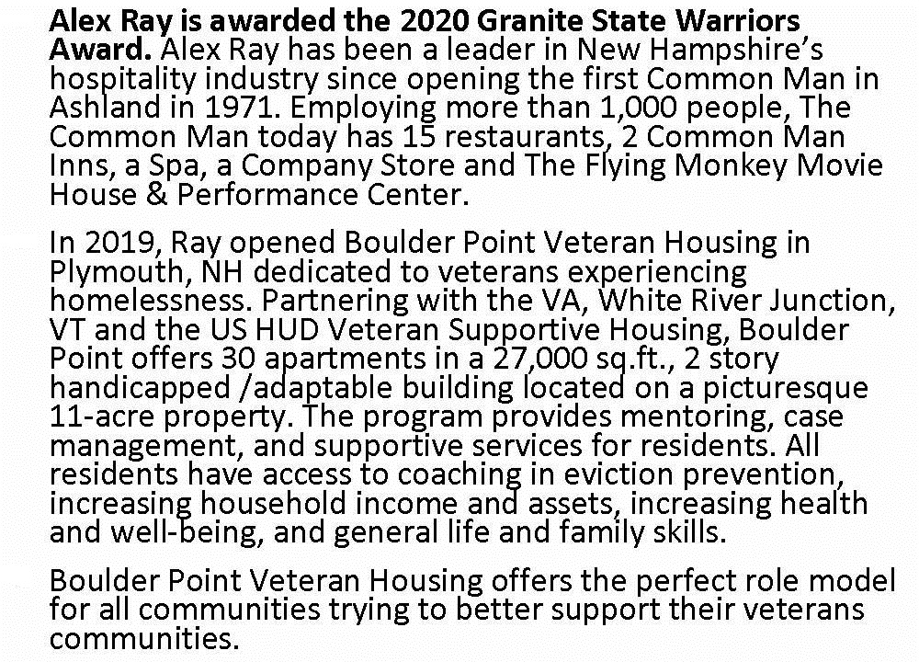
2020 Recipient
5/16/2021
Alex Ray is awarded the 2020 Granite State Warriors Award. Alex Ray has been a leader in New Hampshire’s hospitality industry since opening the first Common Man in Ashland in 1971. Employing more than 1,000 people, The Common Man today has 15 restaurants, 2 Common Man Inns, a Spa, a Company Store and The Flying Monkey Movie House & Performance Center.
In 2019, Ray opened Boulder Point Veteran Housing in Plymouth, NH dedicated to veterans experiencing homelessness. Partnering with the VA, White River Junction, VT and the US HUD Veteran Supportive Housing, Boulder Point offers 30 apartments in a 27,000 sq.ft., 2 story handicapped /adaptable building located on a picturesque 11-acre property. The program provides mentoring, case management, and supportive services for residents. All residents have access to coaching in eviction prevention, increasing household income and assets, increasing health and well-being, and general life and family skills.
Boulder Point Veteran Housing offers the perfect role model for all communities trying to better support their veterans communities.
Alex Ray is awarded the 2020 Granite State Warriors Award. Alex Ray has been a leader in New Hampshire’s hospitality industry since opening the first Common Man in Ashland in 1971. Employing more than 1,000 people, The Common Man today has 15 restaurants, 2 Common Man Inns, a Spa, a Company Store and The Flying Monkey Movie House & Performance Center.
In 2019, Ray opened Boulder Point Veteran Housing in Plymouth, NH dedicated to veterans experiencing homelessness. Partnering with the VA, White River Junction, VT and the US HUD Veteran Supportive Housing, Boulder Point offers 30 apartments in a 27,000 sq.ft., 2 story handicapped /adaptable building located on a picturesque 11-acre property. The program provides mentoring, case management, and supportive services for residents. All residents have access to coaching in eviction prevention, increasing household income and assets, increasing health and well-being, and general life and family skills.
Boulder Point Veteran Housing offers the perfect role model for all communities trying to better support their veterans communities.
2018 MOAA-NH Granite State Warriors Award Page 3

